Slide 1
Programming Fundamentals 1

Slide 2
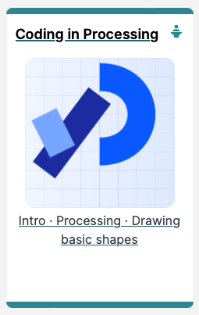
Introduction to Processing
Starting to Code in Processing

Slide 3
Agenda
Coordinate System in Computing
Drawing Shapes
Formatting the Display Window
Flow of Control

Slide 4
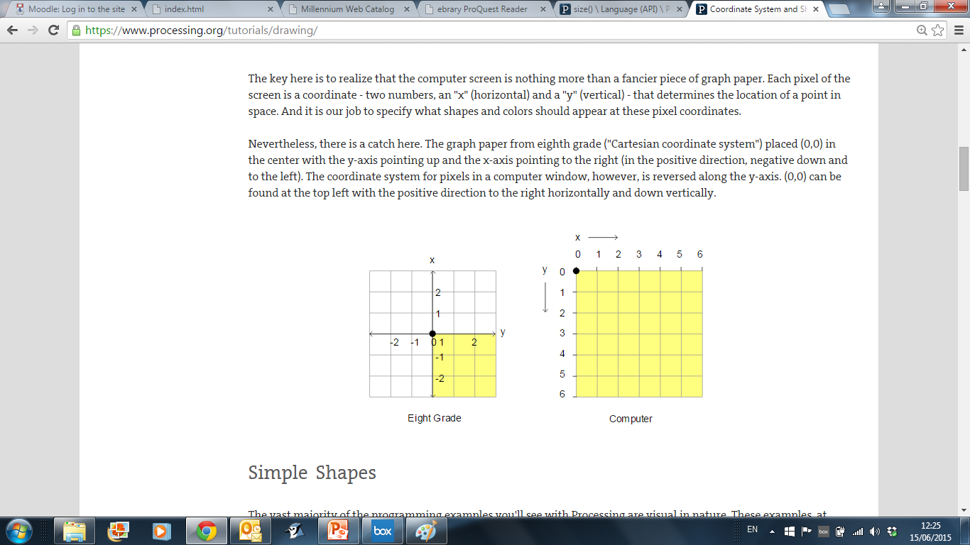
Coordinate System in Computing
In Geometry,
we use this type of
coordinate system:
point (0,0) is in the centre.
In Computing, we use this type of coordinate system to represent the screen:
point (0,0) is in the top left hand corner. Each number is a pixel.

Slide 5

Aside - What is Processing?

Slide 6
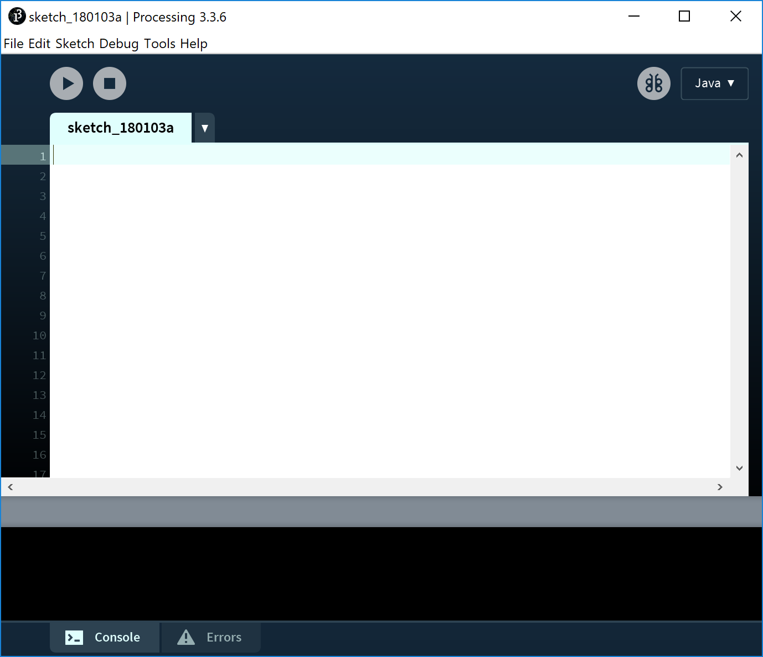
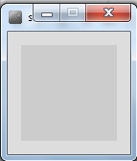
Coordinate System in Computing
Run button
So how does this relate to Processing?
When you open Processing and click on the run button, a display window pops up.
Display window

Slide 7
Coordinate System in Computing
The display window is where your code is run/ displayed.
It follows the rules of the Computing coordinate system i.e. the top left hand corner is (0,0).
A point (10,20) is 10 pixels to the right of (0,0) and 20 pixels below (0,0).
(0,0)
Display window

Slide 8

Drawing Shapes

Slide 9
Functions in Processing
Processing comes with several pre-written functions that we can use.
A function comprises a set of instructions that performs some task.
When you call the function, it performs the task.
We will now look at functions that draw the following shapes:
Rectangle, square, line, oval and circle.

Slide 10
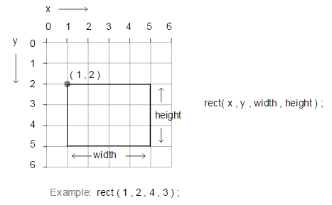
rect()

Slide 11
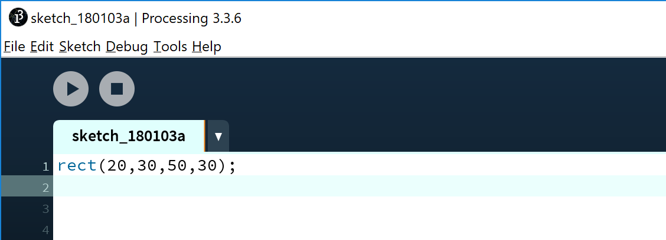
rect() – drawing a rectangle
Notes:
rect(20,30,50,30);

Slide 12
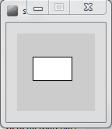
rect() – drawing a rectangle
Click to Run
Notes:
rect(20,30,50,30);

Slide 13
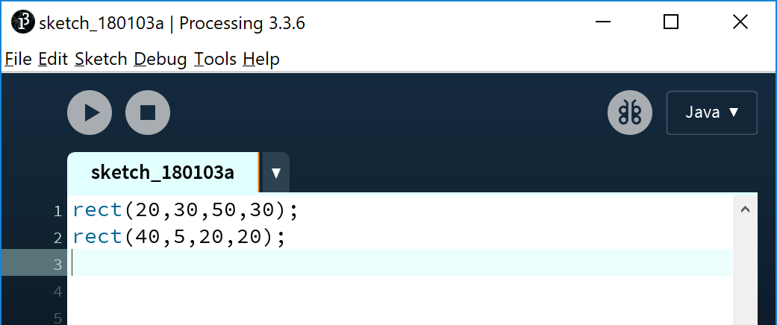
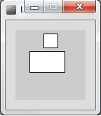
rect() – drawing a square
Note how each line of code has a semi-colon (;) at the end of it. This is called a statement terminator and must be included.
Notes:
rect(20,30,50,30);
rect(40,5,20,20);

Slide 14
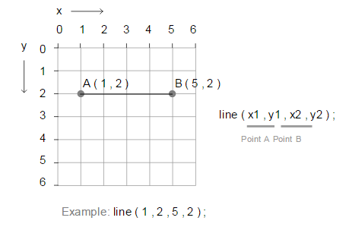
line()

Slide 15

line() – drawing a line
Notes:
rect(20,30,50,30);
rect(40,5,20,20);
line(5,30,20,90);

Slide 16
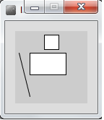
line() – drawing a line
Click to Run
Notes:
rect(20,30,50,30);
rect(40,5,20,20);
line(5,30,20,90);

Slide 17
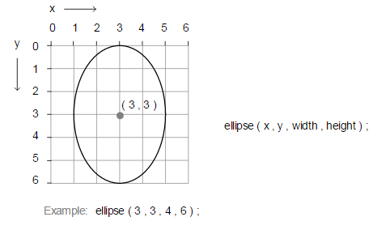
ellipse()

Slide 18
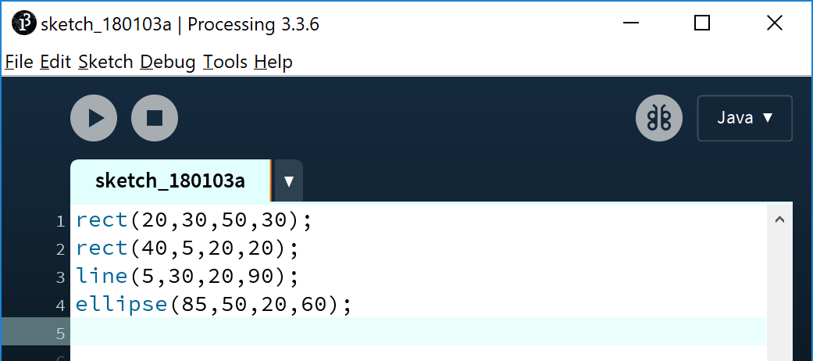
ellipse() – drawing an oval
Notes:
rect(20,30,50,30);
rect(40,5,20,20);
line(5,30,20,90);
ellipse(85,50,20,60);

Slide 19
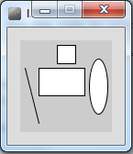
ellipse() – drawing an oval
Click to Run
Notes:
rect(20,30,50,30);
rect(40,5,20,20);
line(5,30,20,90);
ellipse(85,50,20,60);

Slide 20
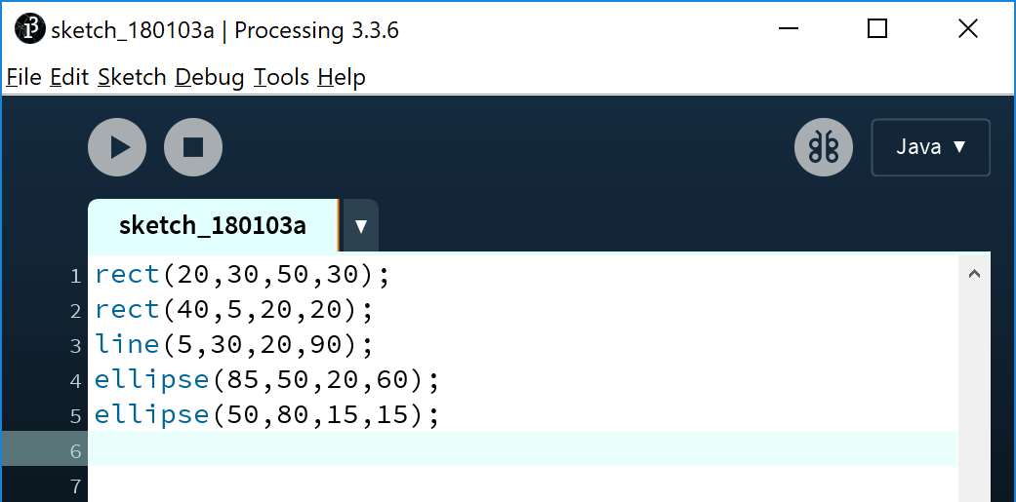
ellipse() – drawing a circle
Notes:
rect(20,30,50,30);
rect(40,5,20,20);
line(5,30,20,90);
ellipse(85,50,20,60);
ellipse(50,80,15,15);

Slide 21
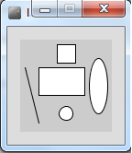
ellipse() – drawing a circle
Click to Run
Notes:
rect(20,30,50,30);
rect(40,5,20,20);
line(5,30,20,90);
ellipse(85,50,20,60);
ellipse(50,80,15,15);

Slide 22
Formatting the Display Window

Slide 23
Formatting the Display Window
Our display window is looking fairly cramped.
The default size of your display window is 100 x 100 pixels, which is quite small.

Slide 24
Formatting the Display Window
We can change the size of the display window by calling the size function.
When you use the size function in static drawings, it has to be the first line of code in your sketchbook.
size(w, h)
w = width of the display window
h = height of the display window

Slide 25
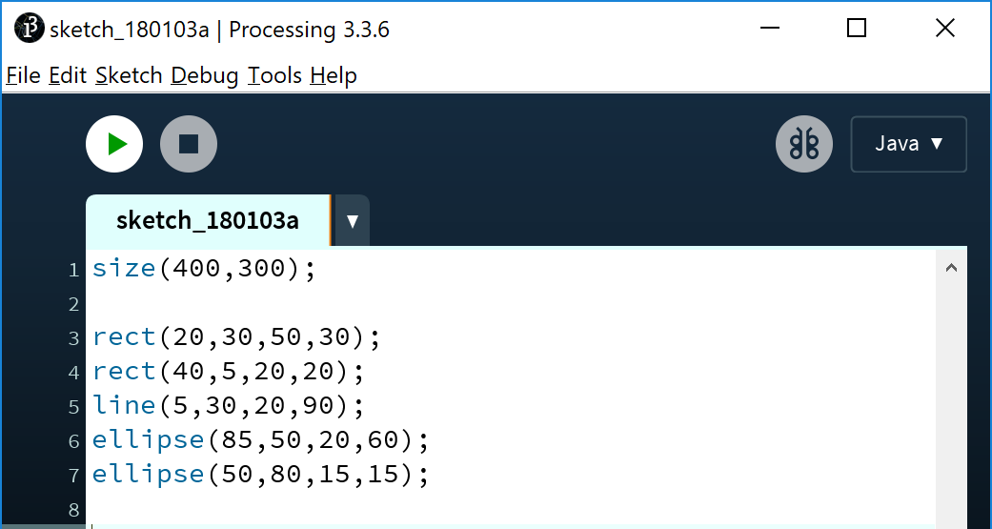
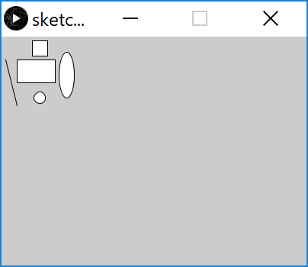
size()
Notes:
size(400,300);
rect(20,30,50,30);
rect(40,5,20,20);
line(5,30,20,90);
ellipse(85,50,20,60);
ellipse(50,80,15,15);

Slide 26
Formatting the Display Window
Our display window looks less cramped now.
But maybe we want to change the default gray colour?
We could use the background function to set the colour to something else.

Slide 27
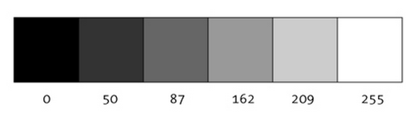
A note on colour first…Grayscale
“0 means black, 255 means white. In between, every other number - 50, 87, 162, 209, and so on - is a shade of gray ranging from black to white.”

Slide 28
background() - syntax
background(grayscale)
grayscale = grayscale colour (a number between 0 [black] and 255 [white] inclusive)

Slide 29

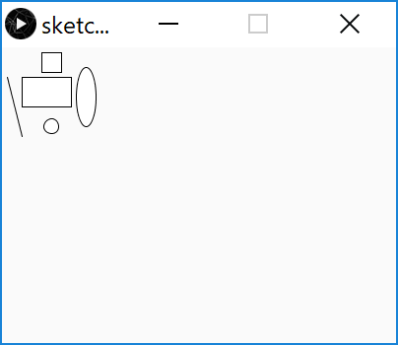
background()
Notes:
size(400,300);
background(250);
rect(20,30,50,30);
rect(40,5,20,20);
line(5,30,20,90);
ellipse(85,50,20,60);
ellipse(50,80,15,15);

Slide 30
Flow of Control

Slide 31

Problem Solving
Programming IS problem solving.
Notes:
You should ALWAYS think about how you are going to solve the programming problem BEFORE jumping in and starting to code.
Give examples of problem being solved e.g. registering students on day 1 of a college course…steps involved are broken down into individual instructions, followed in a particular order (sequence), with some instructions being made conditionally (selection) and some instructions being done repetitively (iteration). Selection could be if they have a previous qualification, do something. Repetition…maybe they have multiple phone numbers that need to be entered?

Slide 32
Flow of Control in a Program
Each program you write will typically have:
Sequence | Things that will be done in a particular order
Selection | Things that will be done conditionally
Iteration | Things that will be done repetitively

Slide 33
Flow of Control in a Program
Each program you write will typically have:
The following example demonstrates Sequence
We will cover Selection and Iteration in future weeks
Sequence | Things that will be done in a particular order
Selection | Things that will be done conditionally
Iteration | Things that will be done repetitively

Slide 34
Sequence of Instructions – Example
Notes:
size(400,300);
background(250);
rect(20,30,50,30);
rect(40,5,20,20);
line(5,30,20,90);
ellipse(85,50,20,60);
ellipse(50,80,15,15);

Slide 35
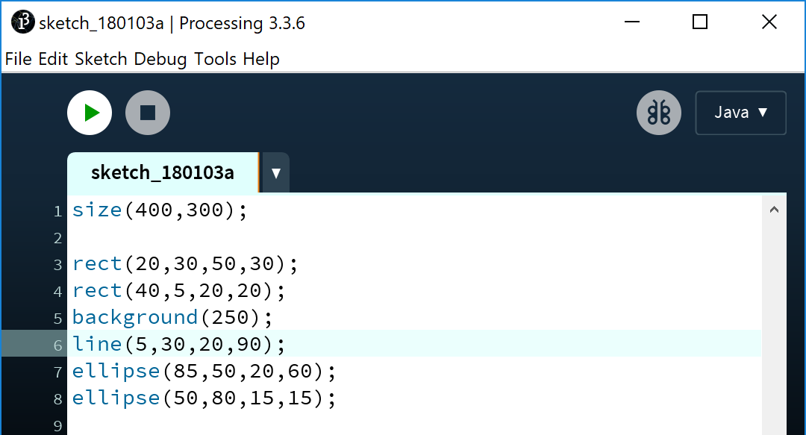
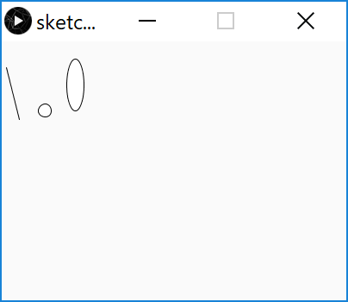
Sequence of Instructions – Matters!!
background(250) moved and is now fourth statement. What happened to the rectangle and square?
Notes:
size(400,300);
background(250);
rect(20,30,50,30);
rect(40,5,20,20);
line(5,30,20,90);
ellipse(85,50,20,60);
ellipse(50,80,15,15);

Slide 36

Questions?

Slide 37



